Slide 1
Final Project: Face Recognition using Deep Neural Network (Part B)
Chaudhari Shalmali

Slide 2
Overview of Part B
Part A was to find the best configuration that can be used to do face recognition on the given dataset of images.
Part B - To do:
Use the best configuration for creating a Single Deep Neural network to do face recognition on the given test data.
Or
Use the best configuration for creating 40 different Deep Neural networks for each subject to do face recognition on the given test data.

Slide 3
Configuration Used
Auto-encoder 1 | Auto-encoder 2 | L2 weight regularization | Sparsity Regularization | Sparsity Proportion | Imposter to Genuine ratio
1000 | 500 | 0.004 | 2 | 0.15 | 2.26
Continued…

Slide 4
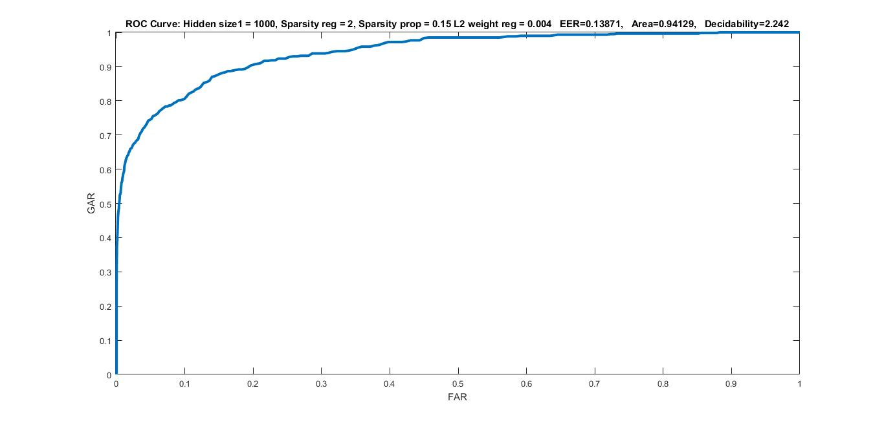

ROC of the Imposter to Genuine ratio

Slide 5
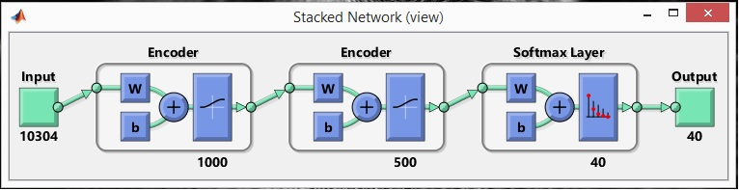
Creating single network for all subjects
Train a softmax layer to classify the feature vectors we got from Part A for all subjects.
Stack the encoders from the auto-encoders together with the softmax layer to form a deep network.
With this full deep neural network formed, compute the results on the test images.

Slide 6
continued…
Reshape the training and the test images into a matrices for using them later.
Find the outputs of Test images using the deep neural network created.
To improve the results for the deep neural network, perform fine tuning on the whole multilayer network i.e. retraining it on the training data.
Find the outputs of Test images using the deep neural network after fine tuning it.
Plot the ROC curve with these outputs and the test target set.

Slide 7
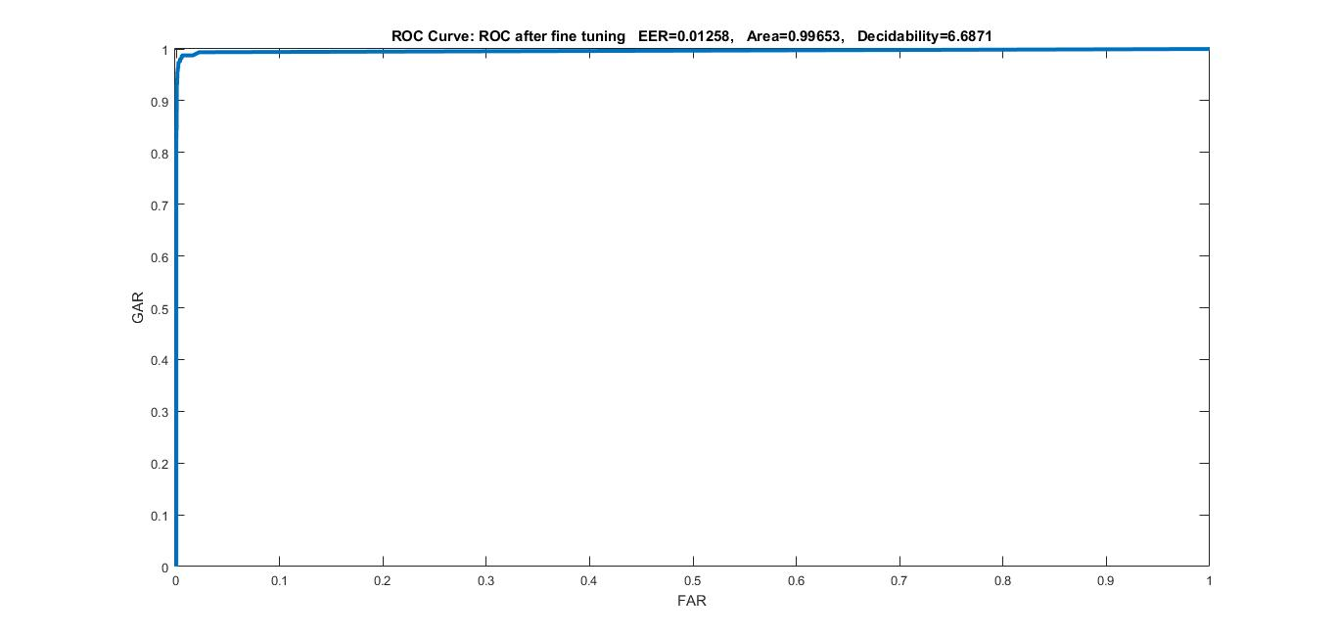
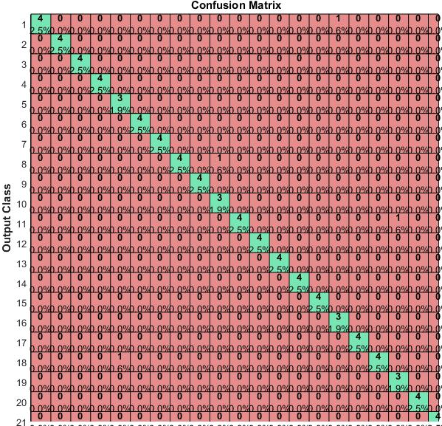
ROC of network after fine tuning the network
(Zoomed in)

Slide 8
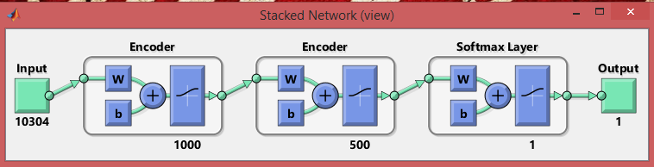
Creating different networks for all subjects
Train a softmax layer to classify the feature vectors we got from Part A for Subject 1.
Stack the encoders from the auto-encoders together with the softmax layer to form a deep network for Subject 1.
With this full deep neural network formed for Subject 1, compute the results on the test images.

Slide 9
continued…
Reshape the training and the test images into a matrices for using them later.
Find the outputs of Test images using the deep neural network created for Subject 1.
To improve the results for this deep neural network, perform fine tuning on the whole multilayer network i.e. retraining it on the training data.
Find the outputs of Test images using the deep neural network after fine tuning it.
Create 40 neural networks for all 40 subjects in the above manner.
Stack the outputs that are found after the fine tuning of the networks.
Plot the ROC curve with these stacked outputs and the test target set.

Slide 10
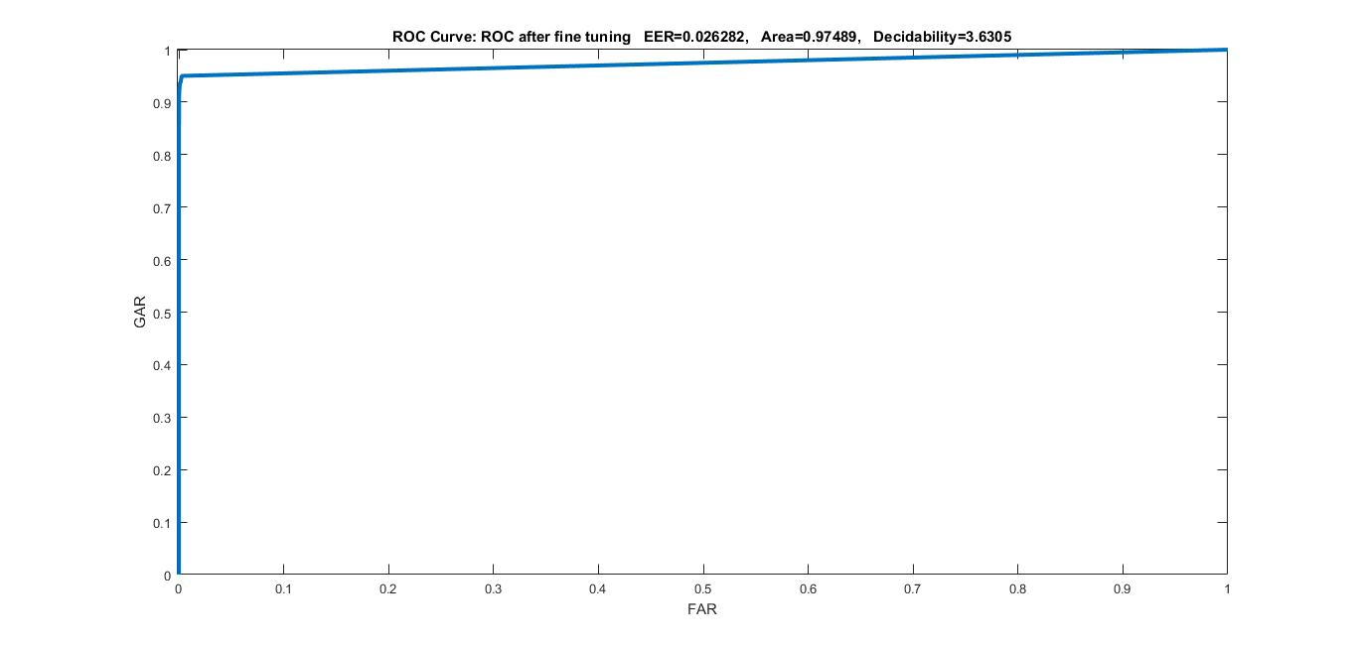
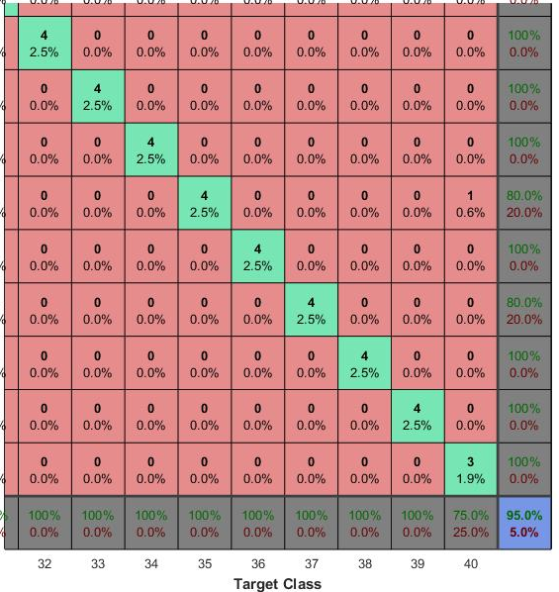
ROC of network after fine tuning the network
(Zoomed in)

Slide 11
THANK YOU !!!

